Slide 1

Deep Learning Basics
汤斯亮（Siliang Tang）
siliang@zju.edu.cn

Slide 2
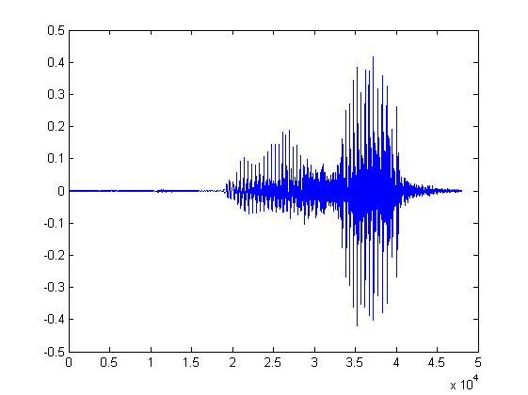

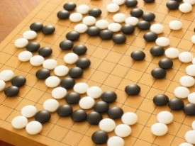
Machine Learning ≈ Looking for a Function
Speech Recognition
Image Recognition
Playing Go
Dialogue System
“How are you”
“Cat”
“5-5”
(next move)
“Hi”
“Hello”
(what the user said)
(system response)

Slide 3
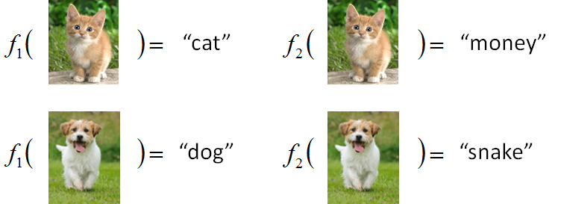



Framework
Image Recognition:
“cat”
A set of function
Model
“monkey”
Better!
Goodness of function f
Supervised Learning
function input:
Training
Data
function output:
“monkey”
“cat”
“dog”

Slide 4
Framework
Image Recognition:
“cat”
A set of function
Model
Training
Testing
“cat”
Step 1
Goodness of function f
Pick the “Best” Function
Using
Step 2
Step 3
Training
Data
“monkey”
“cat”
“dog”

Slide 5
Three Steps for Deep Learning
Step 1: define a set of function
Step 2: goodness of function
Step 3: pick the best function
Neural Network

Slide 6
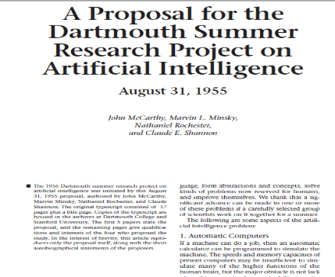
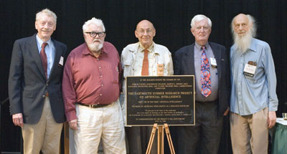
人工智能的诞生
四位学者在1955年提出了人工智能这一术语及研究范畴
John McCarthy (时任Dartmouth数学系助理教授，1971年度图灵奖获得者)
Marvin Lee Minsky (时任哈佛大学数学系和神经学系Junior Fellow，1969年度图灵奖获得)
Claude Shannon (Bell Lab, 信息理论之父)
Nathaniel Rochester(IBM, 第一代通用计算机701主设计师)
让机器能像人那样认知、思考和学习, 即用计算机模拟人的智能。
当年提出AI概念的建议书
AI概念提出50年后，建议人合影
Research Project on Artificial Intelligence , August 31, 1955, Dartmouth

Slide 7
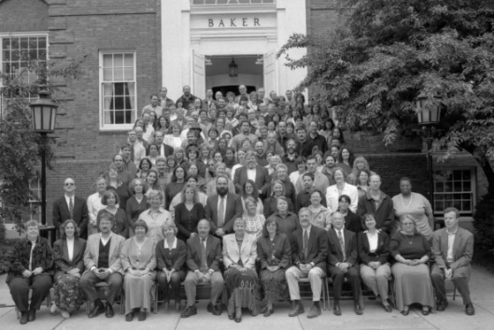
人工智能的诞生
报告列举了Artificial Intelligence所面临七类问题
Automatic Computers
How Can a Computer be Programmed to Use a Language
Neuron Nets
set of (hypothetical) neurons be arranged so as to form concepts
Theory of the Size of a Calculation
Self-improvement (自我学习与提高)
Abstractions
forming abstractions from sensory
Randomness and Creativity
The randomness must be guided by intuition to be efficient
达特茅斯会议合影 (1956年)

Slide 8
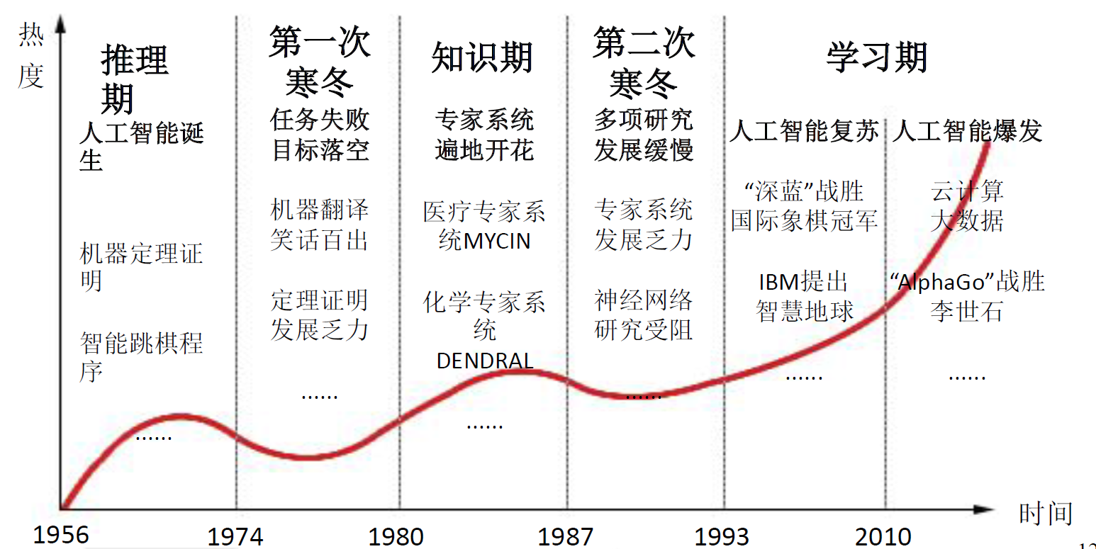
人工智能的曲折历程
AI的三次低谷

Slide 9
Neural Network
Neuron
A simple function
…
…
…
…
Activation function
weights
bias

Slide 10
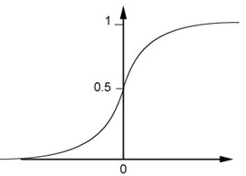
Neural Network
Neuron
Sigmoid Function
2
1
4
-1
-2
0.98
Activation function
-1
1
weights
1
bias

Slide 11
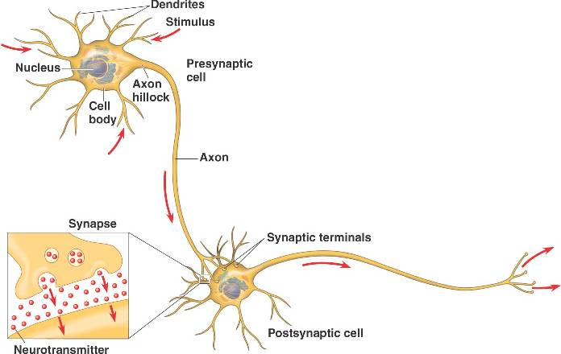
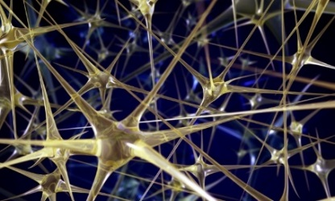

Neural Network
Different connections lead to different network structures
The neurons have different values of weights and biases.
Weights and biases are network parameters $θ$

Slide 12
Fully Connect Feedforward Network
1
4
0.98
1
-2
1
-1
-2
0.12
-1
1
0
Sigmoid Function

Slide 13
Fully Connect Feedforward Network
1
4
0.98
2
0.86
3
0.62
1
-2
-1
-1
1
0
-2
-1
-2
0.12
-2
0.11
-1
0.83
-1
1
-1
4
0
0
2

Slide 14
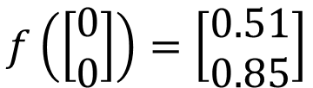
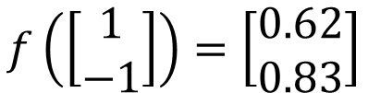

Fully Connect Feedforward Network
1
0.73
2
0.72
3
0.51
0
-2
-1
-1
1
0
-2
-1
0.5
-2
0.12
-1
0.85
0
1
-1
4
0
0
2
This is a function.
$$f\left(\left[\begin{matrix}1 \\ −1\end{matrix}\right]\right)=\left[\begin{matrix}0.62 \\ 0.83\end{matrix}\right]$$
$$f\left(\left[\begin{matrix}0 \\ 0\end{matrix}\right]\right)=\left[\begin{matrix}0.51 \\ 0.85\end{matrix}\right]$$
Input vector, output vector
Given parameters $θ$, define a function
Given network structure, define a function set

Slide 15
Fully Connect Feedforward Network
neuron
Input
Layer 1
Layer 2
Layer L
Output
……
y₁
……
y₂
……
……
……
……
……
……
y_{M}
Input Layer
Output Layer
Hidden Layers
Deep means many hidden layers

Slide 16
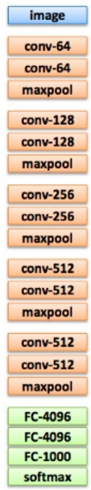
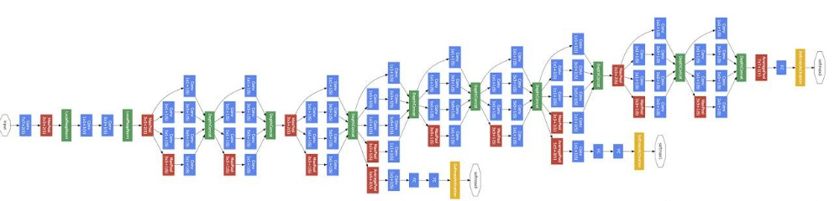
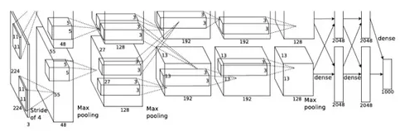
Deep = Many hidden layers
22 layers
http://cs231n.stanford.edu/slides/winter1516_lecture8.pdf
19 layers
8 layers
6.7%
7.3%
16.4%
AlexNet (2012)
VGG (2014)
GoogleNet (2014)

Slide 17
Deep = Many hidden layers
152 layers
Special
structure
3.57%
7.3%
6.7%
16.4%
Residual Net
(2015)
AlexNet (2012)
VGG
(2014)
GoogleNet
(2014)

Slide 18

Why we need deep?
$$≈$$
Shallow & wide
the same number of parameters
Deep & Narrow
Less pieces
More pieces

Slide 19
Three Steps for Deep Learning
Step 1: define a set of function
Step 2: goodness of function
Step 3: pick the best function

Slide 20


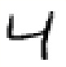





Training Data
Preparing training data: images and their labels
“5”
“0”
“4”
“1”
“9”
“2”
“1”
“3”
The learning target is defined on the training data.

Slide 21
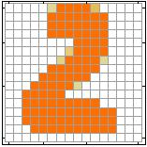


Learning Target
……
y₁
is 1
……
y₂
Softmax
is 2
……
……
……
……
y₁₀
is 0
16 x 16 = 256
Ink → 1
No ink → 0
The learning target is ……
Input:
y₁ has the maximum value
Input:
y₂ has the maximum value

Slide 22
Fully Connect Feedforward Network
neuron
Input
Layer 1
Layer 2
Layer L
Output
……
y₁
……
y₂
……
……
……
……
……
……
y_{M}
Input Layer
Output Layer
Hidden Layers

Slide 23
Output Layer
Softmax layer as the output layer
Ordinary Layer
In general, the output of network can be any value.
May not be easy to interpret

Slide 24
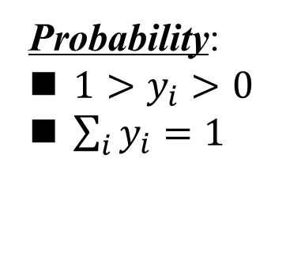
Output Layer
Probability:
$1>y_{i}>0$
$\sum_{i}{y_{i}=1}$
Softmax layer as the output layer
Softmax Layer
3
20
0.88
1
2.7
0.12
-3
0.05
≈0

Slide 25
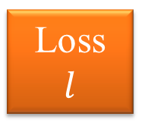
Loss
A good function should make the loss of all examples as small as possible.
“1”
……
y₁
1
As close as possible
……
y₂
Given a set of parameters
0
Softmax
……
……
……
……
……
Loss
$$l$$
……
y₁₀
0
Loss can be square error or cross entropy between the network output and target
target

Slide 26
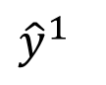
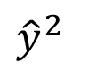
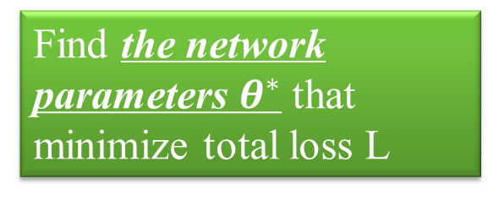
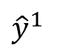
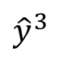
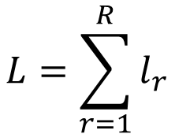
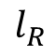
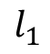
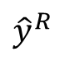
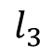
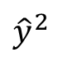
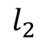
Total Loss
Total Loss:
$$L=\sum_{r=1}^{R}{l_{r}}$$
For all training data …
x¹
NN
y¹
$${\hat{y}}^{1}$$
$$l_{1}$$
As small as possible
x²
NN
y²
$${\hat{y}}^{2}$$
Find a function in function set that minimizes total loss L
$$l_{2}$$
x³
NN
y³
$${\hat{y}}^{3}$$
$$l_{3}$$
……
……
……
……
Find the network parameters $θ^{∗}$ that minimize total loss L
x^{R}
NN
y^{R}
$${\hat{y}}^{R}$$
$$l_{R}$$

Slide 27
Three Steps for Deep Learning
Step 1: define a set of function
Step 2: goodness of function
Step 3: pick the best function

Slide 28

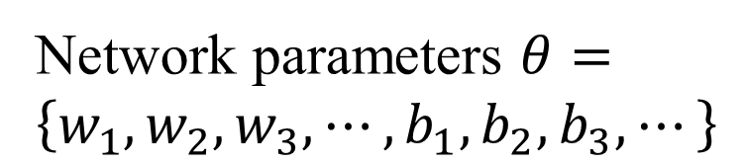
How to pick the best function
Find network parameters $θ^{∗}$ that minimize total loss L
Layer l
Layer l+1
Enumerate all possible values
Network parameters $θ=\left\{w_{1},w_{2},w_{3},⋯,b_{1},b_{2},b_{3},⋯\right\}$
10⁶
weights
……
……
Millions of parameters
E.g. speech recognition: 8 layers and 1000 neurons each layer
1000
neurons
1000
neurons

Slide 29
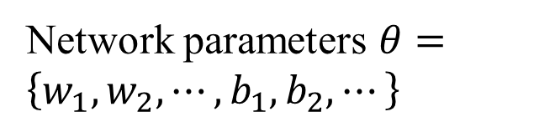
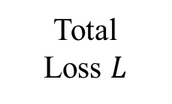
Gradient Descent
Network parameters $θ=\left\{w_{1},w_{2},⋯,b_{1},b_{2},⋯\right\}$
Find network parameters $θ^{∗}$ that minimize total loss L
Pick an initial value for w
Total
Loss $L$
Random, RBM pre-train
Usually good enough

Slide 30

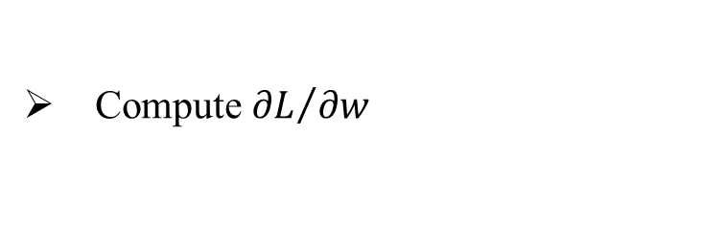
Gradient Descent
Network parameters $θ=\left\{w_{1},w_{2},⋯,b_{1},b_{2},⋯\right\}$
Find network parameters $θ^{∗}$ that minimize total loss L
Pick an initial value for w
Total
Loss $L$
Compute ${∂L}/{∂w}$
Negative
Increase w
Positive
Decrease w

Slide 31
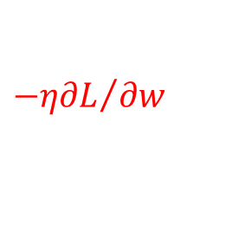
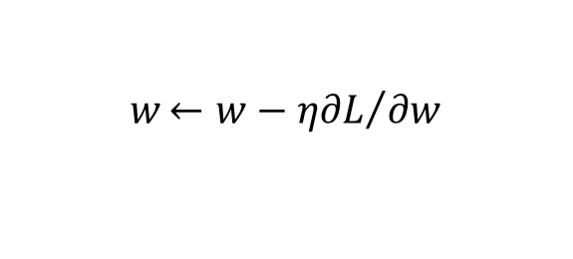
Gradient Descent
Network parameters $θ=\left\{w_{1},w_{2},⋯,b_{1},b_{2},⋯\right\}$
Find network parameters $θ^{∗}$ that minimize total loss L
Pick an initial value for w
Total
Loss $L$
Compute ${∂L}/{∂w}$
$$w{←w−η∂L}/{∂w}$$
Repeat
η is called “learning rate”
$${−η∂L}/{∂w}$$

Slide 32
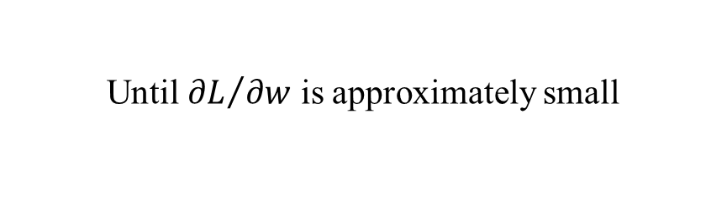
Gradient Descent
Network parameters $θ=\left\{w_{1},w_{2},⋯,b_{1},b_{2},⋯\right\}$
Find network parameters $θ^{∗}$ that minimize total loss L
Pick an initial value for w
Total
Loss $L$
Compute ${∂L}/{∂w}$
$$w{←w−η∂L}/{∂w}$$
Repeat
Until ${∂L}/{∂w}$ is approximately small
(when update is little)

Slide 33
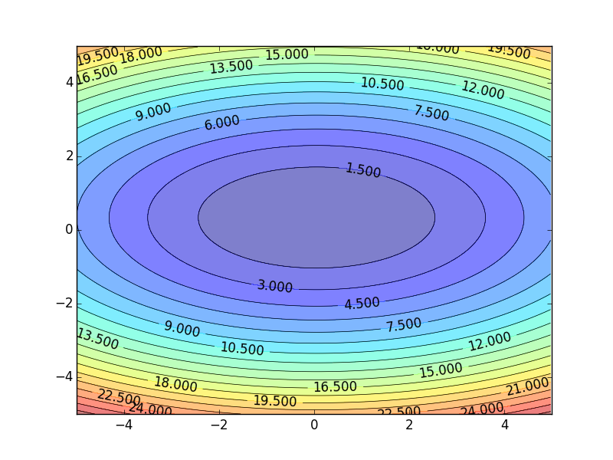
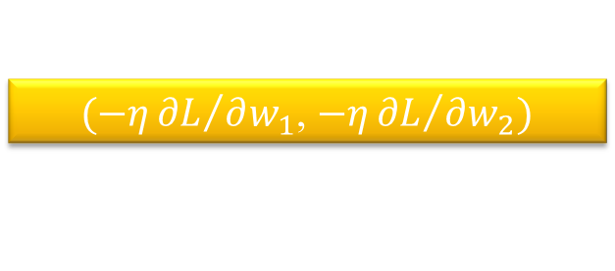
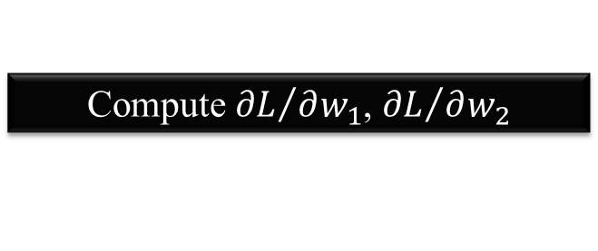
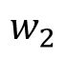
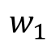
Gradient Descent
Hopfully, we would reach a minima …..
Color: Value of Total Loss L
$$w_{2}$$
$(−η{∂L}/{∂w_{1}}$, $−η{∂L}/{∂w_{2}})$
Compute ${∂L}/{∂w_{1}}$, ${∂L}/{∂w_{2}}$
$$w_{1}$$

Slide 34
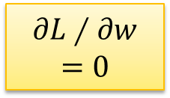
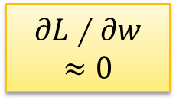

Local Minima
Total
Loss
Very slow at the plateau
Stuck at saddle point
Stuck at local minima
$$∂L∕∂w$$
$$≈0$$
$$∂L∕∂w$$
$$=0$$
$$∂L∕∂w$$
$$=0$$
The value of a network parameter w

Slide 35
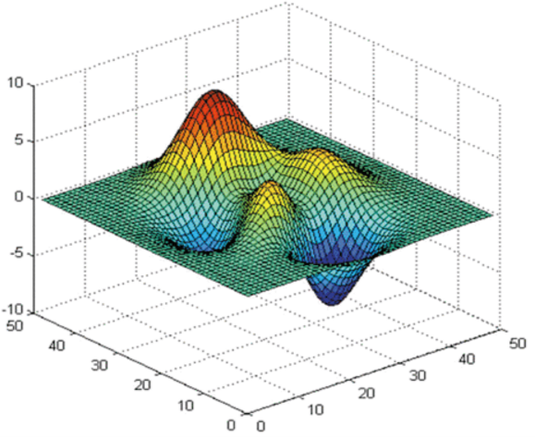
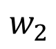
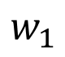
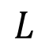
Local Minima
Gradient descent never guarantee global minima
Different initial point
$$L$$
Reach different minima, so different results
$$w_{1}$$
$$w_{2}$$

Slide 36


Gradient Descent
This is the “learning” of machines in deep learning ……
Even alpha go using this approach.
People image ……
Actually …..
I hope you are not too disappointed :p

Slide 37






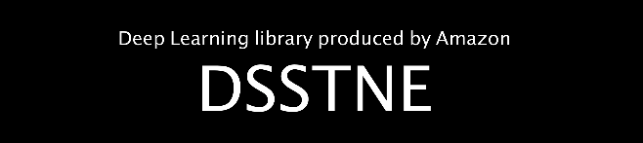


Backpropagation
Backpropagation: an efficient way to compute ${∂L}/{∂w}$ in neural network

Slide 38
Recent advances in DL theory

Slide 39



Neural Tangent Kernel
深度神经网络的泛化能力不能用传统机器学习理论来解释，NTK (NNGP) 等方法从数学上证明了在无限参数条件下，深度神经网络会退化为NTK/NNGP
https://ai.googleblog.com/2020/03/fast-and-easy-infinitely-wide-networks.html

Slide 40






Deep Networks from First Principles
目前主流卷积神经网络的设计可以通过Rate Reduction出发导出

Slide 41






Deep Networks are Kernel Machines
测试样本
训练样本
核函数（学习到的 ）
以往的观点认为神经网络可以发现新的特征，但这篇论文证明了只要模型使用的优化方式是梯度下降，那么实际上模型只是在记忆之前的样本
https://arxiv.org/abs/2012.00152

Slide 42
Any Questions?

